Slide 1
Be A Scout & Online Applications
February 2, 2021

Slide 2
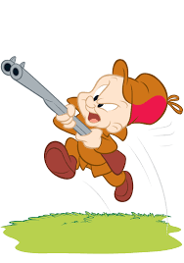
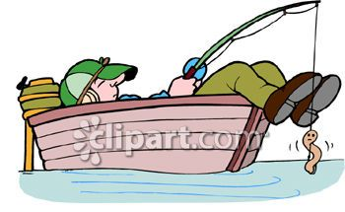
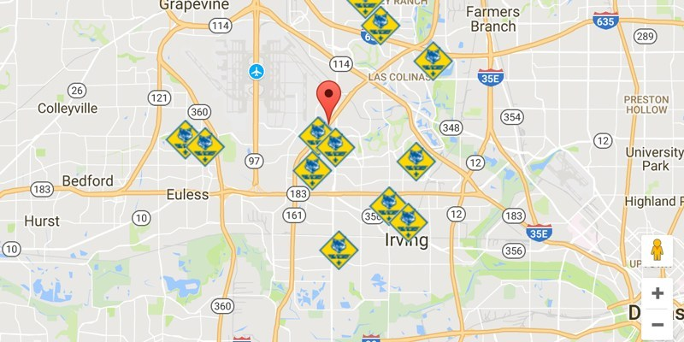
Pop Quiz!
What story do these images tell?
Notes:
What story do these images tell
Jay Bunning on Invitation Manager

Slide 3
Agenda
BeAScout.org
Pin Management
Turning on online applications
Becoming a Family Pack
Invitation Manager
Application Manager
Youth Applications
Adult Applications
Organization Manager
Organization Security Manager
Follow-up expectations and protocols
Who to contact for help…
Notes:
Should the CC recommend adults?
Should the COR delegate?

Slide 4
By the Numbers…
36 New Leads on
Be-A-Scout since 1/1/2021
11 Leads more than 7 days old have not been contacted. ☹
Notes:
30% of our FREE leads have not been contacted in a timely manner!!!
Leads time-out after 60 days
36 leads x 12 months = 432 scouts for the year.

Slide 5
Membership Expectations
Automatic emails are sent to Unit Key 3 twice a week, for any leads and applications
Weekly emails will be sent to from Council staff for pending leads. Commissioners to be copied.
Unit Committee Chairs will receive a phone call from Council staff if a lead has not been contacted after 7 days.
Staff and Membership Committee take ownership of lead if not contacted after 14 days…
No one wants to get to this step!!
Notes:
We are not going to do your job for you.

Slide 6
Who to contact for support…
Website: www.craterlakecouncil.org/beascout
Unit Commissioner
Membership Committee
Looking for enthusiastic, self-starters in each district & program
District Executive & Council Staff

Slide 7
Thank you for you time and dedication to scouting!
Questions? Answers!
Erik Johnsen
VP – Membership Erik@Cairnipc.com
Crater Lake Council (541) 324-9953

