Slide 1
Cub Scout Pack _____________
Crater Lake Council, Boy Scouts of America
New Family Orientation
Notes:
The following slideshow may be adjusted to fit your unit’s needs. To facilitate the Orientation please select print note pages when you print the document in order to get all of the information that goes with each slide. Feel free to customize the presentation as necessary. Slides 13-17 may be customized as needed by the unit. Units may choose to abridge slides 6 and 7 depending on how soon after the start of the Cub Scouting year the New Family Orientation has taken place.

Slide 2
Fun of Cub Scouting
Group Activities
Outdoor adventures
Life Skills and Values
Field Trips and Community Awareness
STEM engagement
New experiences with friends
Everyone can participate – Do Your Best

Slide 3
Why Cub Scouting?
Get outdoors and out from in front of the television or video games
Get to interact with kids his own age face-to-face instead of through a computer program
Be exposed to positive role models in a safe and exciting environment
Become more confident and develop a better sense of self-esteem and early leadership skills
Notes:
Let’s talk for just a moment about Why Cub Scouting? I shared with you earlier why I am involved in Scouting, but everyone joins Cub Scouting for different reasons. In front of you are a couple of different reasons that parents have shared with me.
Scouting is a year round experience, but many Scouts and their families choose Scouting because of its outdoor activities. Today many children spend much of their time in front of the television, playing video games, or on a computer. It is good for youth to get outside and be active and Scouting helps to facilitate that.
The age at which youth engage in Facebook, Twitter, and text messaging seems to get younger and younger and many youth are communicating digitally instead of face-to-face. Scouting gives youth an opportunity to have face-to-face interactions with kids their own age and have positive interactions with adults.
Scouting also helps Scouts develop a better sense of self-esteem. Scouts will have an opportunity to do their best and recognized for their achievement.

Slide 4
Welcome to Cub Scouting!
Introductions
Visitors
Parents and families
Pack leadership
Assisting Boy Scouts
Notes:
Welcome to Cub Scouting—the best program for a boy in 1st through 5th grade and his family!
My name is _____________________________ and my role in Scouting is _______________________________ (position). I decided to get involved with Scouting ________________ (how many years ago) because _____________________________ (share a little bit about why you chose to get involved in Scouting and what it has meant to you, your family, your community, or anything positive that you would like to share).
I would like to take a moment to make some introductions for tonight. First, I would like to welcome our visitors (visitors may include prospects, Council or District leadership/staff, visitors from the chartering organization). I would like to welcome all of our parents (take a moment and let them introduce themselves). With us tonight are members of our pack leadership. (introduce pack leadership that is present). Finally, we have some members of the local Boy Scout troop that work with us on a regular basis. You may see some of these Scouts/leaders attending some of our meetings throughout the year (introduce the Boy Scout leaders).

Slide 5
Purpose of Cub Scouting
Helping build character and encourage spiritual growth
Developing habits and attitudes of good citizenship
Encouraging good sportsmanship and pride in growing strong in mind and body
Strengthening family relationship
Fostering a sense of personal achievement by developing new interests and skills
Notes:
There are 10 key purposes to the Cub Scout Program and those are
Character Development
Spiritual Growth
Good Citizenship
Sportsmanship and Fitness
Family Understanding
Respectful relationships
Personal Achievement
Friendly Service
Fun and Adventure
Preparation for Boy Scouts
Through the many programs that we will be conducting as part of the den and the pack we will be incorporating all of these 10 key purposes, especially, having fun!

Slide 6
How Does Cub Scouting Work?
Your son joins a Cub Scout Pack
The Pack is made up of Cub Scout Dens - a group of boys in the same grade level
The Cub Scout Pack meets monthly
Show of new skills
Recognition
Family Fun
Notes:
When a boy joins Cub Scouting he is joining with his family. The family is the basis of Cub Scouting and Cub Scouting exists to support your family and help enrich your family time together.
Boys and their families become part of a Cub Scout Den. A Cub Scout Den is a small group of boys in the same grade level who meet weekly. Each Cub Scout Den has a Den Leader who helps to plan and carry out each Den meeting. Sometimes, boys from the local Boy Scout Troop known as Den Chiefs will come and be a part of our meeting and help teach our Scouts scout skills.
All dens, from grades 1 through 5, make up a Cub Scout Pack. Once a month, the dens with their families come together at the pack meeting. At the pack meeting, boys show off the new skills they have learned during the month and are recognized with the badges they have earned. The pack is lead by the Cubmaster, who plans out some exciting events throughout the year. Some of our special pack meetings include___________________ (talk about some of the specific events like Pinewood Derby, Blue and Gold Banquet, Father-son cake bake, or anything that your pack does special.

Slide 7
Cub Scout Dens Den Leaders are Parent Volunteers
The Tiger Cub Den
Boys in Grade 1
.
The Wolf Cub Den
Boys in Grade 2
.
Notes:
Italic items are optional depending on the length of your presentation and information.
For boys who are in First Grade or at least 7 years old, they can join the Tiger Cub Den. The boy and his parent or guardian attend all the den meetings and activities. For each requirement for the Tiger Badge there is a family activity, a den activity, and a Go See It activity. Some of the requirements for the Tiger Badge include: Making my family special where a boy and his family make a family scrapbook and visit a library or historical place in their community; Keeping Myself Healthy and Safe where a boy and his family practice a fire drill at home and then learn the rules of a game or sport and play it; and Let’s go Outdoors where the boy and his family get to have an experience in the outdoors.
For boys who are in Second grade or at least 8 years old, they can join the Wolf Cub Den. A wolf Scout works on 12 achievements to earn his Wolf Badge. Some of the requirements for the Wolf Badge include: Feats of Skill which emphasizes boys staying physically active through games and sports; Making Choices where a boy is taught what to do in certain situations that he may encounter such as what to do if approached by a stranger, how to recognize a bully in school and what to do, and what to do if left at home alone; and Tools for Fixing and Building where a boy learns how to use simple tools like a screwdriver, hammer, and pliers to build or fix something.

Slide 8
Cub Scout Dens
The Bear Cub Den
Boys in Grade 3
The Webelos Den
Boys in Grades 4 and 5
Transition to Boy Scouts in 5th Grade
Notes:
Italic items are optional depending on the length of your presentation and information.
For boys who are in Third Grade or are at least 9 years old, they can join the Bear Cub Den. A Bear Scout works to complete 12 of 24 achievements to earn his Bear Badge. These achievements continue to teach simple skills and promote interest in the world around him. Some of these achievements are What Makes America Special, where Scouts learn about how our country works; Sharing Your World With Wildlife, where Scouts learn about nature and the creatures that share our planet; and Family Outdoor Adventure, where Scouts learn about being safe while having a great time in the outdoors.
For boys who are in fourth and fifth grade or are at least 10 years old, they can join the Webelos Den. A Webelos Scout works on requirements for the Webelos Badge, works on the 20 activity pins, and eventually can work on his Arrow of Light—the highest award in Cub Scouting. Webelos continues to teach Scouts great things such as swimming while they work on the Aquanaut pin, some really great things about the world of science as they work on their Scientist pin, the ins and outs of camping outdoors through their Outdoorsman pin, and what they can do to be a great citizen through their Citizen pin.
Additionally, we aim to graduate every Webelos Scout into Boy Scouting. This is where we work with out local troop so that your son is ready to take that next step in February or March of his fifth grade year.

Slide 9
About our Pack
Cubmaster runs pack meeting
The Pack Committee supports the pack program
Should Includes:
Pack Committee Chairman
Treasurer, Secretary, Event Chairs
Chartered Organization Representative
Parent Volunteers
The Chartered Organization
Our Chartered Organization is _______________
Notes:
You have met some of the key leaders in our pack, but crucial to the success of our pack is our Pack Committee and our Pack’s Charter Partner.
The Pack committee is made up of the committee chairman, the treasurer, the Chartered Organization Representative, other interested adults, and parents of our Cub Scouts.
The committee meets once a month or more often if needed. The committee helps to select leadership, finds meeting places, performs record keeping, manages pack finances, orders badges, maintains pack equipment, helps train leaders, and recognizes leaders. It may sounds like a lot of work, but with everyone doing a little bit we can have a fantastic Cub Scouting year!
The Chartered Organization actually owns our pack and we are chartered by ____________________________________________ (charter organization name). The Charter Organization approves leadership, helps secure a meeting place, keeps the pack with in their guidelines as well as the policies and guidelines of the Boy Scouts of America.

Slide 10
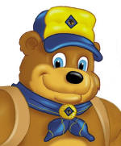
How can I get involved?
Be an active part of our Pack Committee
Serve as an Assistant Cubmaster, Den Leader, Assistant Den Leader
Help with a Pack Special Event
All families are expected to help
“Cub Scouts is parents teaching character to their child and their friends”
Notes:
Our pack operates through all volunteer leadership. Being a leader is fun, challenging, and rewarding. Leaders find their experiences help them to become even better parents as they get to spend extra time with their son. Some reasons that parents choose to be leaders include:
Wanting to be a part of the fun and fellowship with other families sharing in the pride of their boys’ accomplishments
A chance to help their son and his friends to become good citizens
They were Scouts themselves and want their son to have the same fun experiences they had
Love of the outdoors and wanting an environment to share that with their son
A big concern of many new parents is that they don’t know anything about Scouting and don’t think they will make a good leader. The fact is that many new leaders don’t know a lot about Scouting when they start but end up being great leaders. There are many training opportunities to help a brand new parent learn the ins and outs of Scouting. Some of the trainings can even be taken at home any time of the day. Another concern that parents have is that they don’t have enough time during the week to be a Scout leader. On average our leaders spend __________ hours working on getting ready for our Scout meeting and actually going to the meeting. We have a great number of resources available in print and electronically that lead you step-by-step in what to do for every meeting during our Scouting year. There will be some additional things like camping trips or special activities, but many of those are pack events and at no time are you ever along in trying to put this together.
If you don’t think that you have time to commit to be a leader, we are always looking for help with some of the special events in our pack such as our Blue and Gold Banquet, our Pinewood Derby, or our Popcorn Sale. If you feel more comfortable in helping to plan and organize those events we would be happy for your help!

Slide 11
Your Pack is Not Alone
The Crater Lake Council www.craterlakecouncil.org facebook.com/clc 541-664-1444
Your District
Wild Rivers
Fremont
Klamath Falls
Pacific Rivers
Notes:
Our Pack is part of the Northeast Illinois Council. The Northeast Illinois Council is responsible for all Scouting programs in Lake and Northern Cook County The council has a service center in Lancaster with a Scout Shop that sells uniforms, awards, and general Scouting supplies. The service center in Highland Park is also home to our Field Services department with full-time professional staff who serve each part of the council.
Our council is broken down into 3 districts. Our Pack is in the ____________________________________ District. A Scouting district is a geographical region of the BSA local council that has its own volunteer support committee and commissioner staff to help each unit.

Slide 12
Scouting is a Safe Adventure!
Youth Protection Training for Youth and Adults
Two-deep leadership
No one-on-one contact
Separate accommodations for youth and adults
No hazing
No bullying
Privacy of youth respected
Buddy System
Notes:
As I mentioned before, the Boy Scouts of America offers convenient training for everyone—parents, leaders, and youth members. This orientation has been designed to help you learn a little about Cub Scouting and the wonderful year-round adventure that you and your son have become a part of. If you would be interested in finding out about more training, you can log on to www.scouting.org and click on the “Parent” tab and then the “Training” section and you will be able to check out the online trainings for yourself.
Leaders are also trained in our Age-appropriate guidelines which help to define what activities are appropriate for the correct age groups in Scouting.
Every leader in our pack is a registered member of the Boy Scouts of America, which means they have passed a background check and have taken what we call Youth Protection Training. Child abuse is a serious problem in our society, and unfortunately, it can occur anywhere, even in Scouting. Youth safety is of paramount importance to Scouting that is why we make certain that our leaders are the right individuals to be working with your Scout.
Information on our Youth Protection program can be found online and in the front cover of your son’s handbook. A couple of highlights of our program are:
Two-deep leadership at all times. For all events that the unit has there will always be at minimum 2 adults present. At least one of those adults must be a registered member of the BSA and the other may be a parent or a guardian.
No one-on-one contact. In everything that we do in the Cub Scout program there will be no one-on-one Scout and adult interaction. If there is a time that there needs to be a counseling session a parent will be brought in or the session will be conducted with in open view of other adults.
Separate accommodations for youth and adults. An adult and a youth must not be in a situation where they are staying in the same tent together, unless the adult and youth are parent and child.
No hazing or bullying. Hazing and bullying are not consistent with the values that we strive to teach our Scouts and do not have a place in any event with our pack. If there is an issue or perceived issue it should be brought up to unit leadership right away so that it can be dealt with appropriately.
Privacy of youth is respected. At all of our camping facilities there are separate accommodations for adults and youth.
Buddy system. All boys are taught to travel with a youth buddy for any activity or meeting that they are involved in.

Slide 13
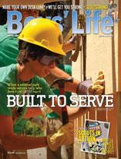
How much does Scouting Cost?
One-time Youth Joining Fee ------------$25
Annual Registration youth------- $108
Annual Registration Adult--------$81
Pack Dues---------------------- $_____
Boys’ Life magazine---------- $15
(Optional, but strongly recommended)
Notes:
(Pack Dues vary from Pack to Pack so please feel free to customize this slide as it seems fit. Some packs lump everything together into one fee, while others break things down)
Boys’ Life is a great resource. It is a magazine for boys and adults that is delivered monthly and has interesting features on Scouting, sports, hobbies, magic, award winning fiction, science and U.S. history. There are also jokes, comics, and short stories. You should have received a miniature version of the magazine in your son’s New Scout Packet.

Slide 14
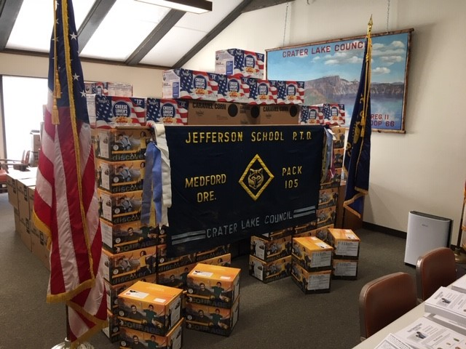
Pack Fundraisers
Trail’s End Popcorn Sale
Notes:
To help pay for the many awards and activities you and your son will be participating in this year, we will be doing several fundraisers. One of our major fundraisers is the Trails End Popcorn sale. The popcorn sale along with our other fundraising projects are opportunities for your son to “earn his way” in paying for Scouting activities available to him. Product selling teaches Scouts selling and communication skills. In addition to that, you son can qualify for some fantastic prizes!
(The rest of this slide can be customized per each unit.)

Slide 15
Uniform
Consists of shirt, neckerchief, slide, and hat
Worn at Scouting events
Place where all earned recognition items go
Available at the Scout Shop
Crater Lake Council (councilstuff.com)
Notes:
(This is just a brief description of uniforming. Packs may choose to edit this in regards to pieces that they might not use or pieces that they might give out to new Scouts. Packs may also decide to talk about a Pack activity shirt if they utilize a piece like that for different Scouting functions and events)

Slide 16
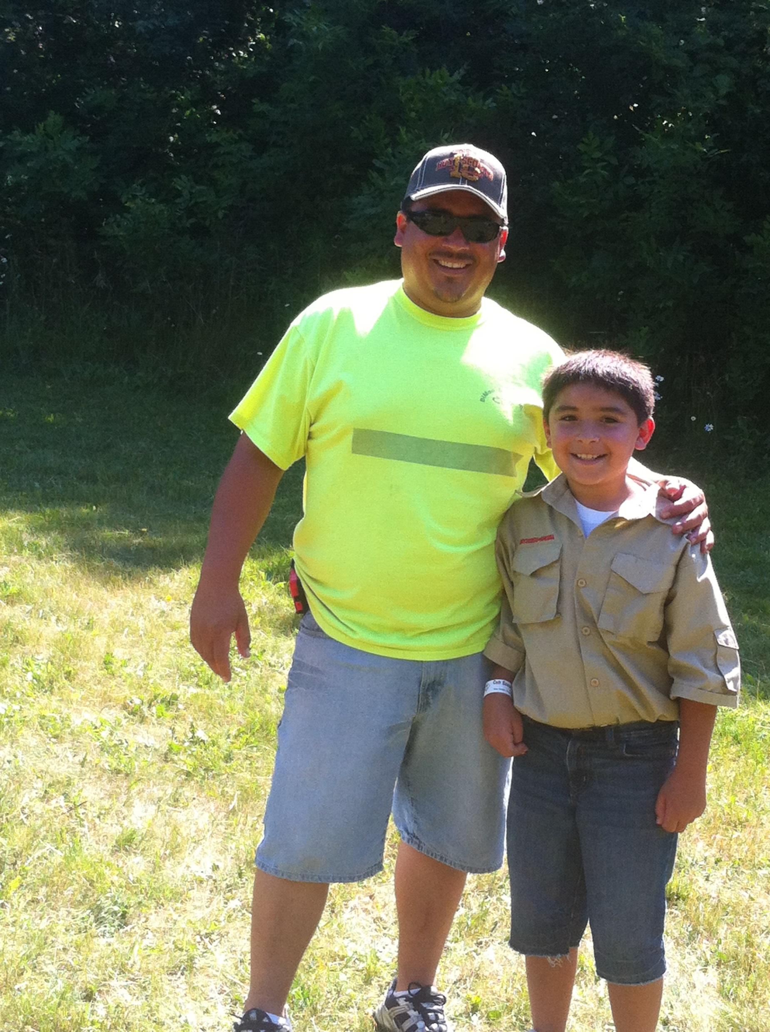
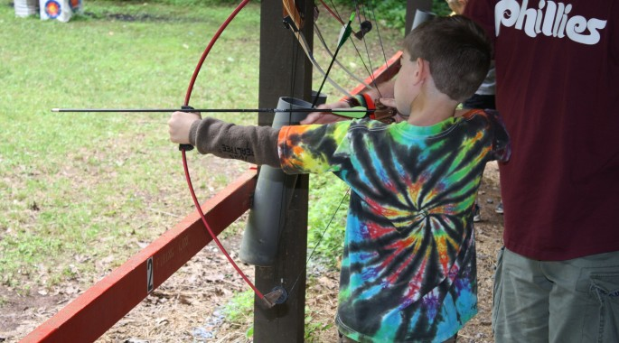
Camping Activities
Cub Scouts camp with qualified leaders
Cub Scouts develop camping skills and learn self reliance
Cub Scouts have FUN!!
Council Cub Camps include:
BB Gun Shooting, Archery, Boating, Nature, Bicycling, and much more
Notes:
Going camping is one of the ultimate experiences for any Cub Scout and there are lots of great opportunities for camping close by. In addition to boys getting to do things like shoot BB guns and bow and arrows, paddle a boat, learn about nature, go on a pump bike bicycle course, go fishing, and go swimming, boys learn skills that they will be able to take with them their entire life.
(Share information specifically about Camp Mack, district breakfast hikes, or other events that the pack does on an annual or regular basis. Camping is one of the things that gets kids excited about Scouting and whatever we can do to highlight these experiences will hopefully get their parents excited too!)

Slide 17
Sports and Other Activities
Cub Scouts and sports do mix well!!!
Scout schedules are flexible
Sports skills and scout leadership skills are complementary
Scout requirements promotes physical fitness
Notes:
It is possible for a Cub Scout to be involved with his den and his pack and still participate in sports. Many Scouts actually do both. Communication is key and if your son has conflicts between sports and scouting, please know that we can be flexible. It is important to remember that sports skills and scout leadership skills are complimentary. A scout definitely makes for a great captain or a leader of a sports team and Scouting helps to prepare him for that responsibility. As you have heard in this program, Scouting requirements often involve physical fitness and encourage your son to be active in a sport or activity that he really enjoys.

Slide 18
Fun, Friendship, and Memories
Notes:
The founder of the Scouting movement, Baden Powell, once said that “Scouting is a game with a purpose.”
In a society where your son is often taught that winning is everything, sometimes it is forgotten that the process of doing something—the game itself--and giving it his best effort is often times more important than whether he wins or loses. In Cub Scouting your son will:
Learn new physical skills through sports, crafts, and games
Learn how to get along with others through group activities
Reinforce mental skills such as writing and calculating
Develop personal independence
Have a chance to develop a closer family bond with you
Learn the importance of the outdoors and be able to appreciate the world around him
And in doing on of these things have FUN while making friends and memories that will last a lifetime.
The Game is Scouting and the purpose is to prepare Scouts to be the best that they can be during their lifetime!

Slide 19
Questions

Slide 20
Thank-you for coming!
For any additional questions please contact:
________________________ (name)
________________________ (phone/email
Or
Notes:
Thank-you all for coming out this evening. If you think of any questions after tonight please don’t hesitate to contact me at ______________________________ or for questions about Scouting in general you can contact the Northeast Illinois Council, BSA at 717-394-4063.
Before you leave tonight if you have not filled out a family talent survey please do so and return it to me. If you do not have all the information for your Adventure Plan, we will be happy to help you fill in the all of the correct contact information.
Our next meeting will be _________________________________________________. Welcome to Cub Scouting at Pack ________________!

